Slide 1
Understanding Join, Union & subqueries in SQL

Slide 2
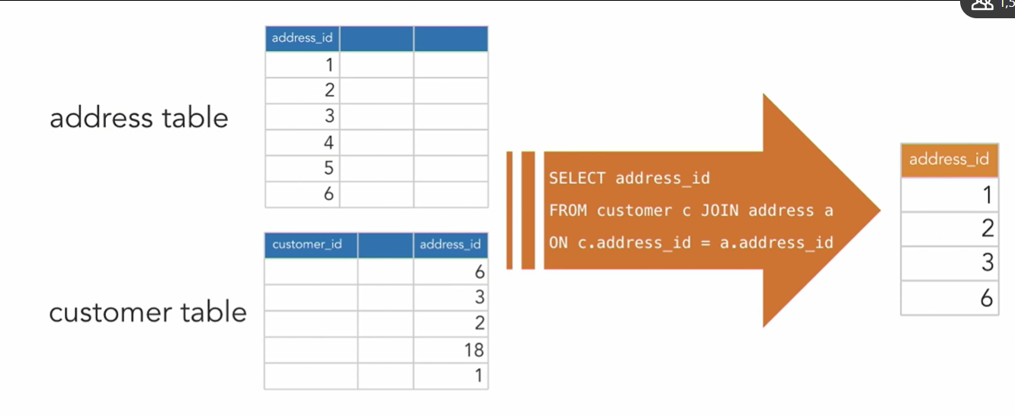
Inner Join

Slide 3
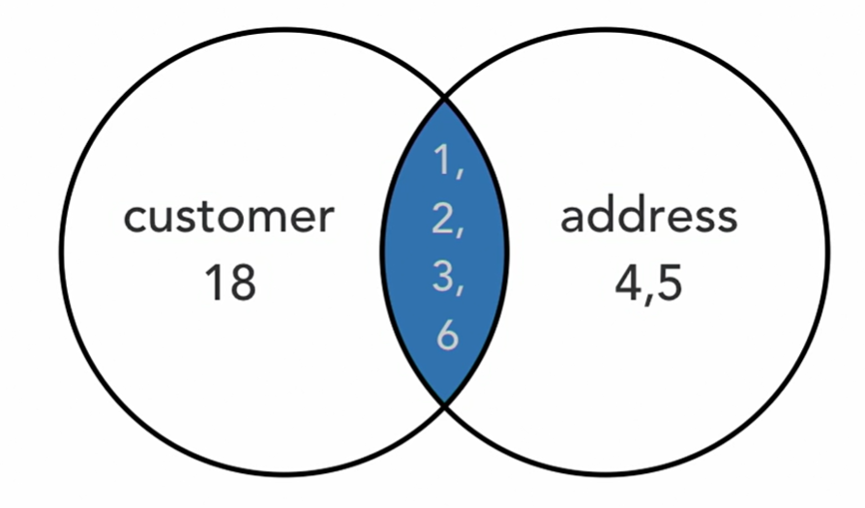
Inner Join or Join using Venn diagram

Slide 4

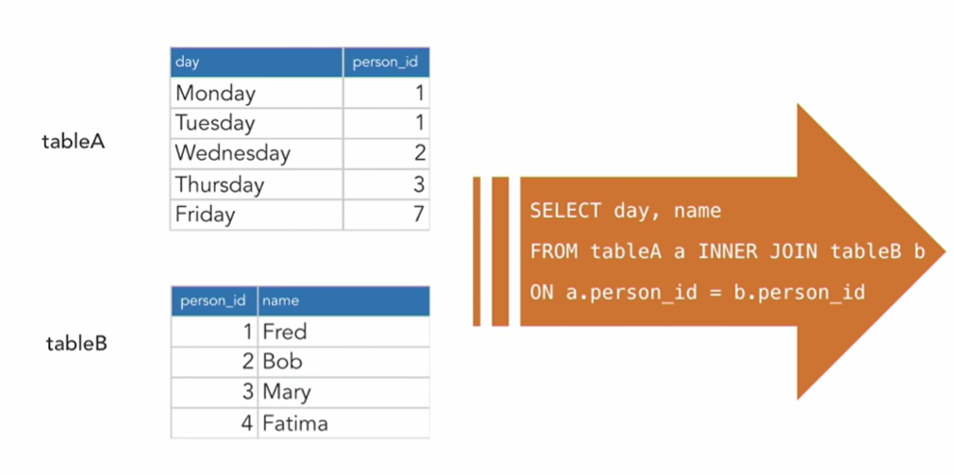
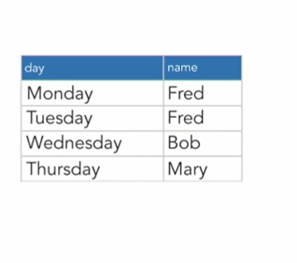
Inner Join or Join

Slide 5
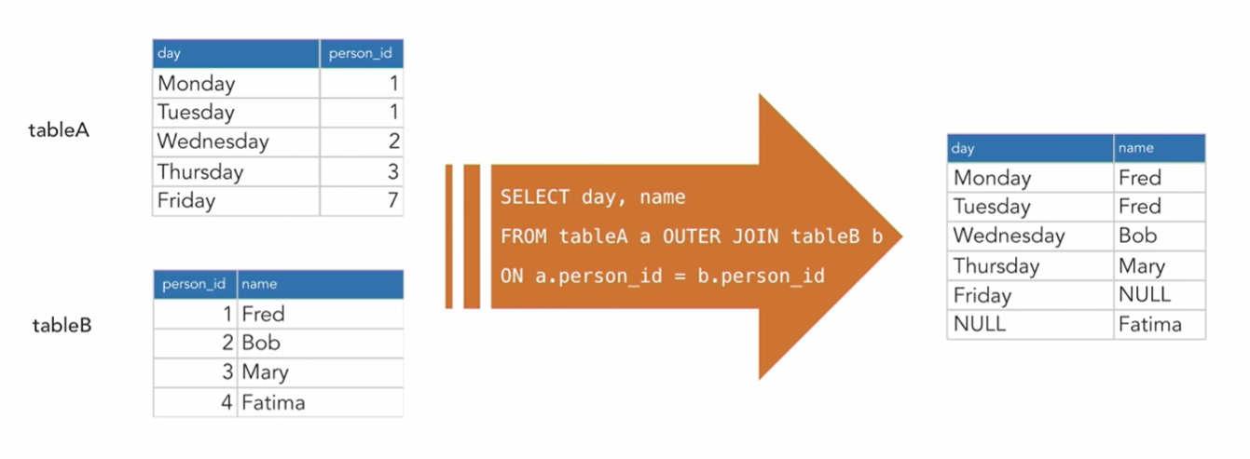
Full join or Outer join – Returns all rows, whether or not there is a match within tables

Slide 6
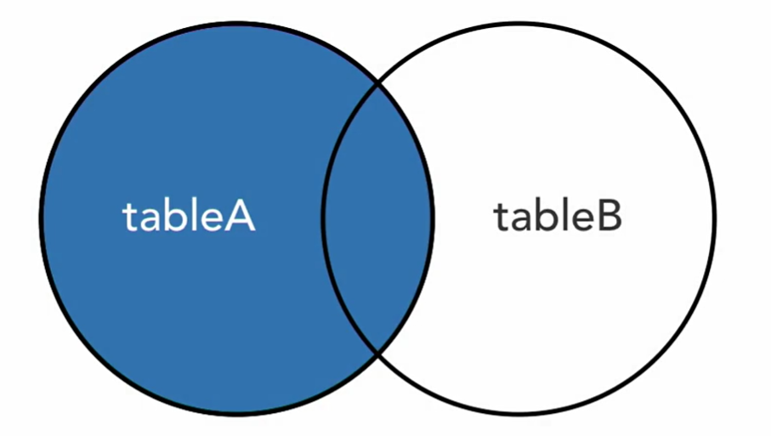
Left join or left outer join : Returns all records from the table to the left of the keyword “JOIN”.

Slide 7
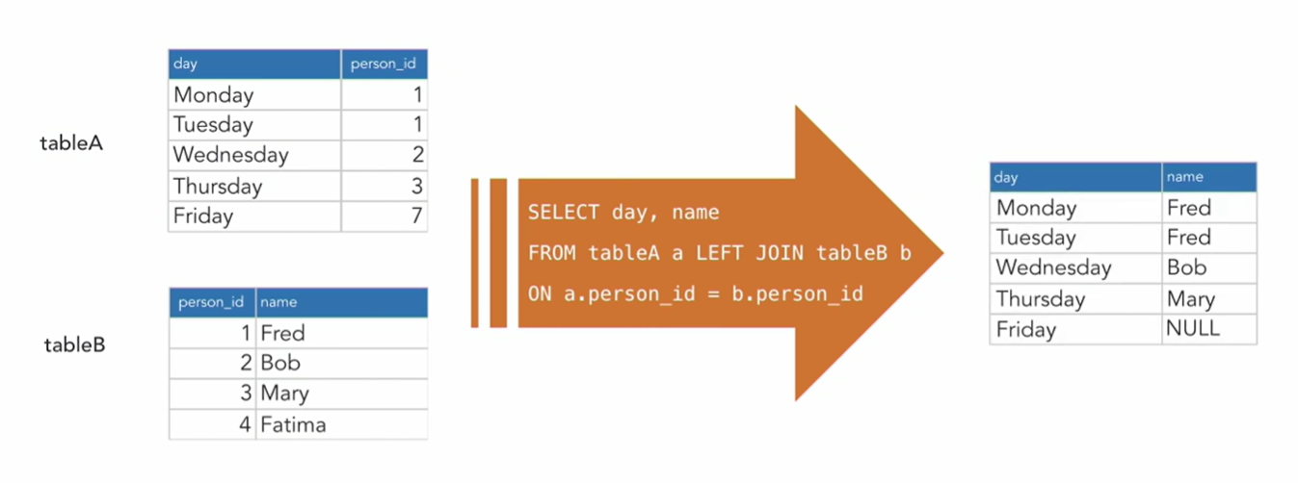
Left join or Left outer join

Slide 8
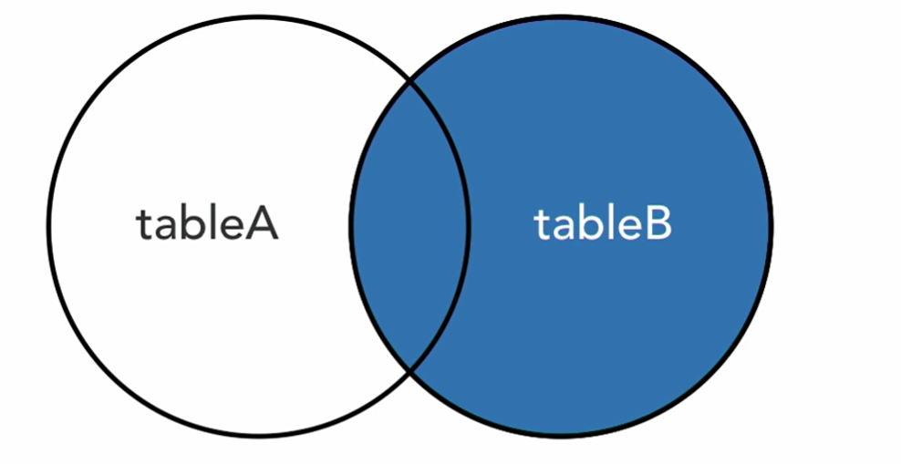
Right Join or Right Outer join

Slide 9
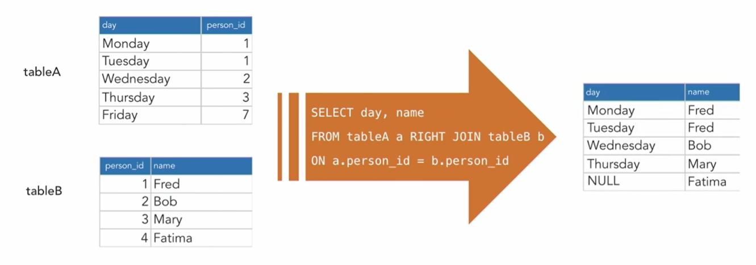
Right join or Right outer join : Returns all records from the table to the right of the keyword “JOIN”

Slide 10
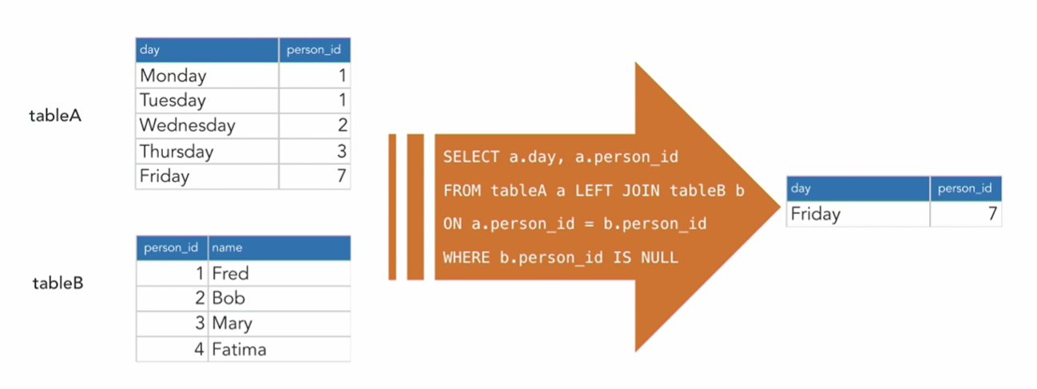
Display mismatch row using left join

Slide 11
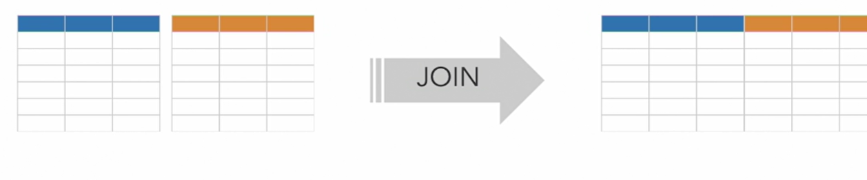
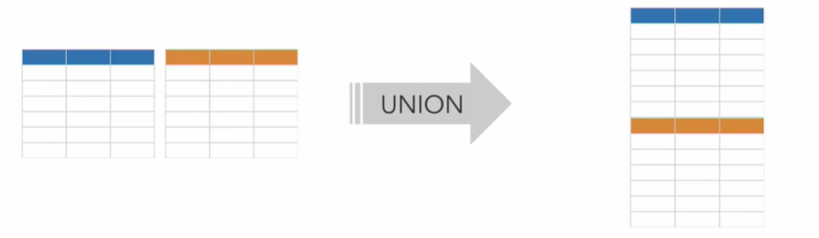
Join vs Unions
JOINs merge data horizontally. When we join 2 tables of three fields each, we get one table of 6 fields
Unions merges vertically. A union of the same two tables with 6 rows each gives us one table of three fields and 12 rows

